Slide 1
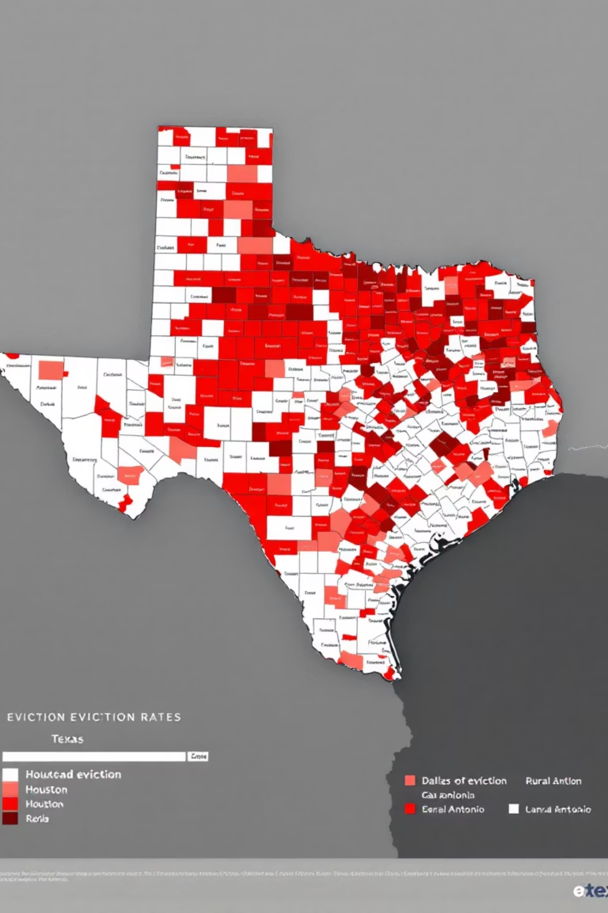
Eviction and Census Data Analysis in Texas (2020-2023)
An executive analysis of eviction filings across Texas census tracts, examining socioeconomic and racial disparities using U.S. Census data (2017-2023) and monthly eviction filings (2020-2023).

Slide 2
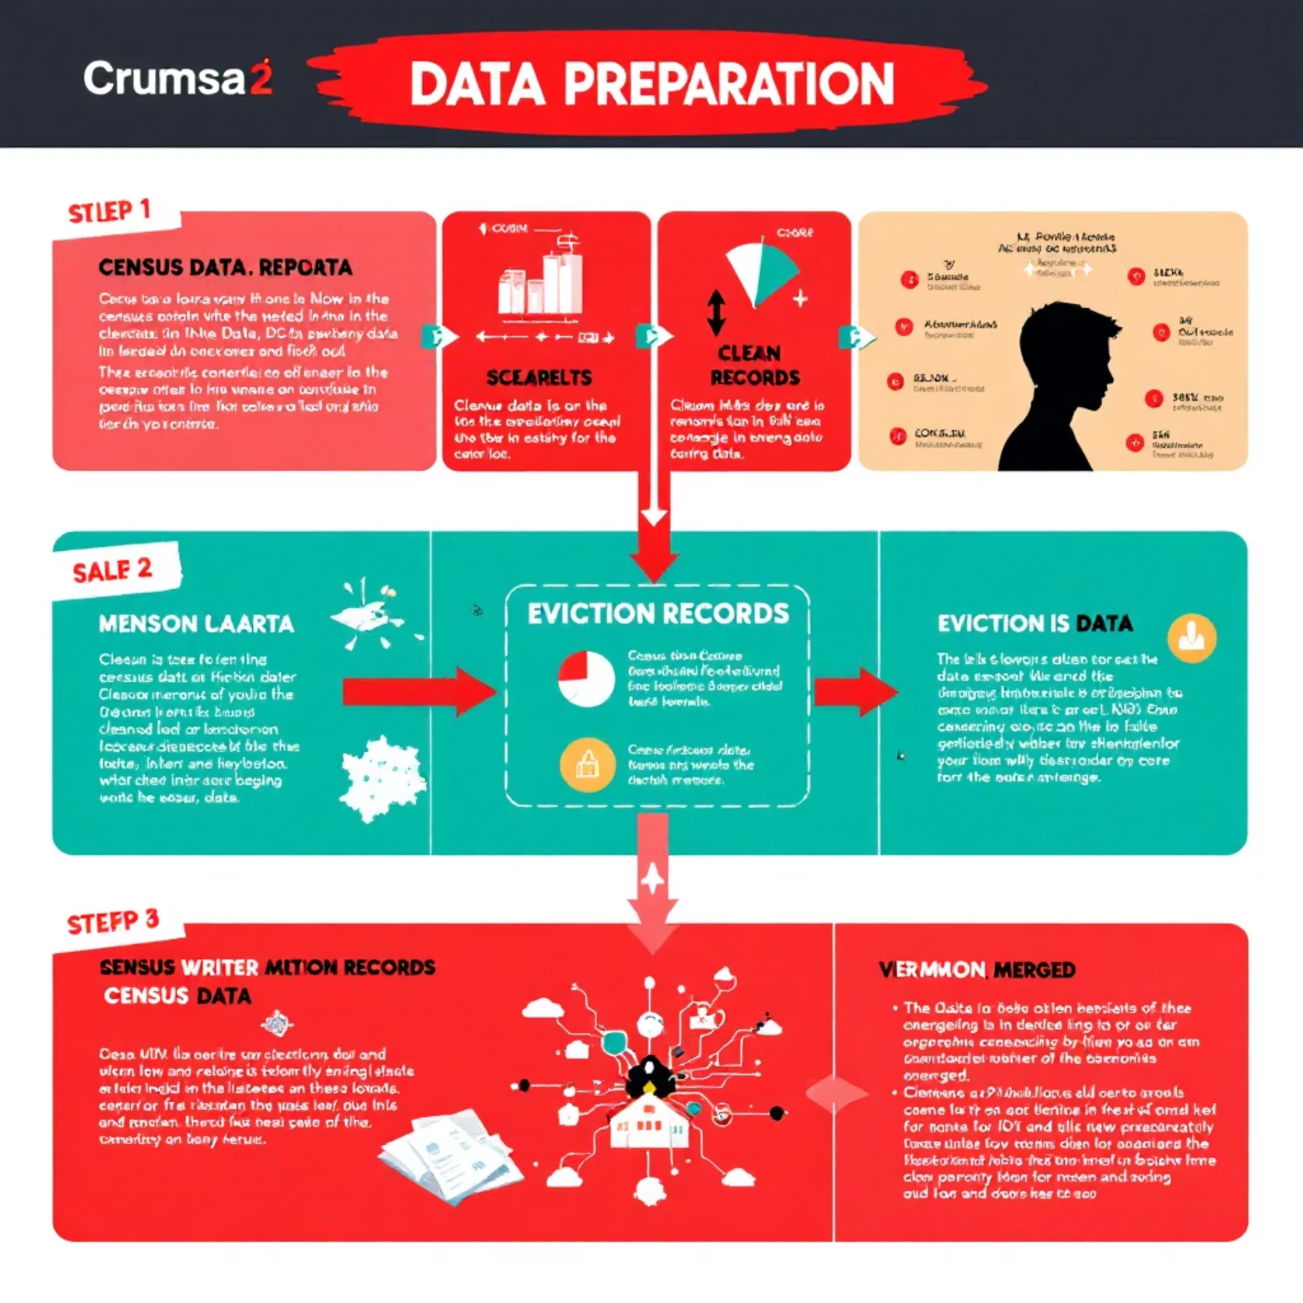
Data Sources and Preparation
Primary Data Sources
Census Data (2017-2023): Demographic and socioeconomic indicators at census tract level
Eviction Data (2020-2023): Monthly filings per census tract
Shapefile (2021): Texas census tract geometries for mapping
Data were cleaned to remove placeholders (e.g., -888888888) and imputed using medians for fields with <5% missingness. All GEOID fields were converted to strings for proper joins.

Slide 3
Feature Engineering
1
2
Eviction Rate per 1k Residents
Pct Renter x Poverty
(filings_avg / Total Population) * 1000
Renter Occupied (%) * Poverty Rate (%) / 100
3
4
Pct Uninsured x HS or Less
Poverty to Education Ratio
Uninsured (%) * HS or Less (%) / 100
Poverty Rate (%) / HS or Less (%)
Additional features included Youth Burden (Under 18% / Total Population), Female to Pop Ratio, and High Renter Flag (1 if Renter Occupied > 50% else 0). These features showed moderate to strong correlations with eviction rates.

Slide 4
Bias and Disparity Analysis
Majority Race
Eviction Rate/1k
Poverty Rate (%)
Uninsured x HS or Less
Black
3.59
22.8
16.68
Hispanic
1.09
21.0
11.81
White
0.86
8.3
5.52
Insight: Eviction risk is disproportionately high in Black-majority tracts. The top census tracts by raw eviction filings exceeded 3,000 filings in 2020 alone. Vulnerability indicators are significantly elevated in Black and Hispanic tracts.

Slide 5
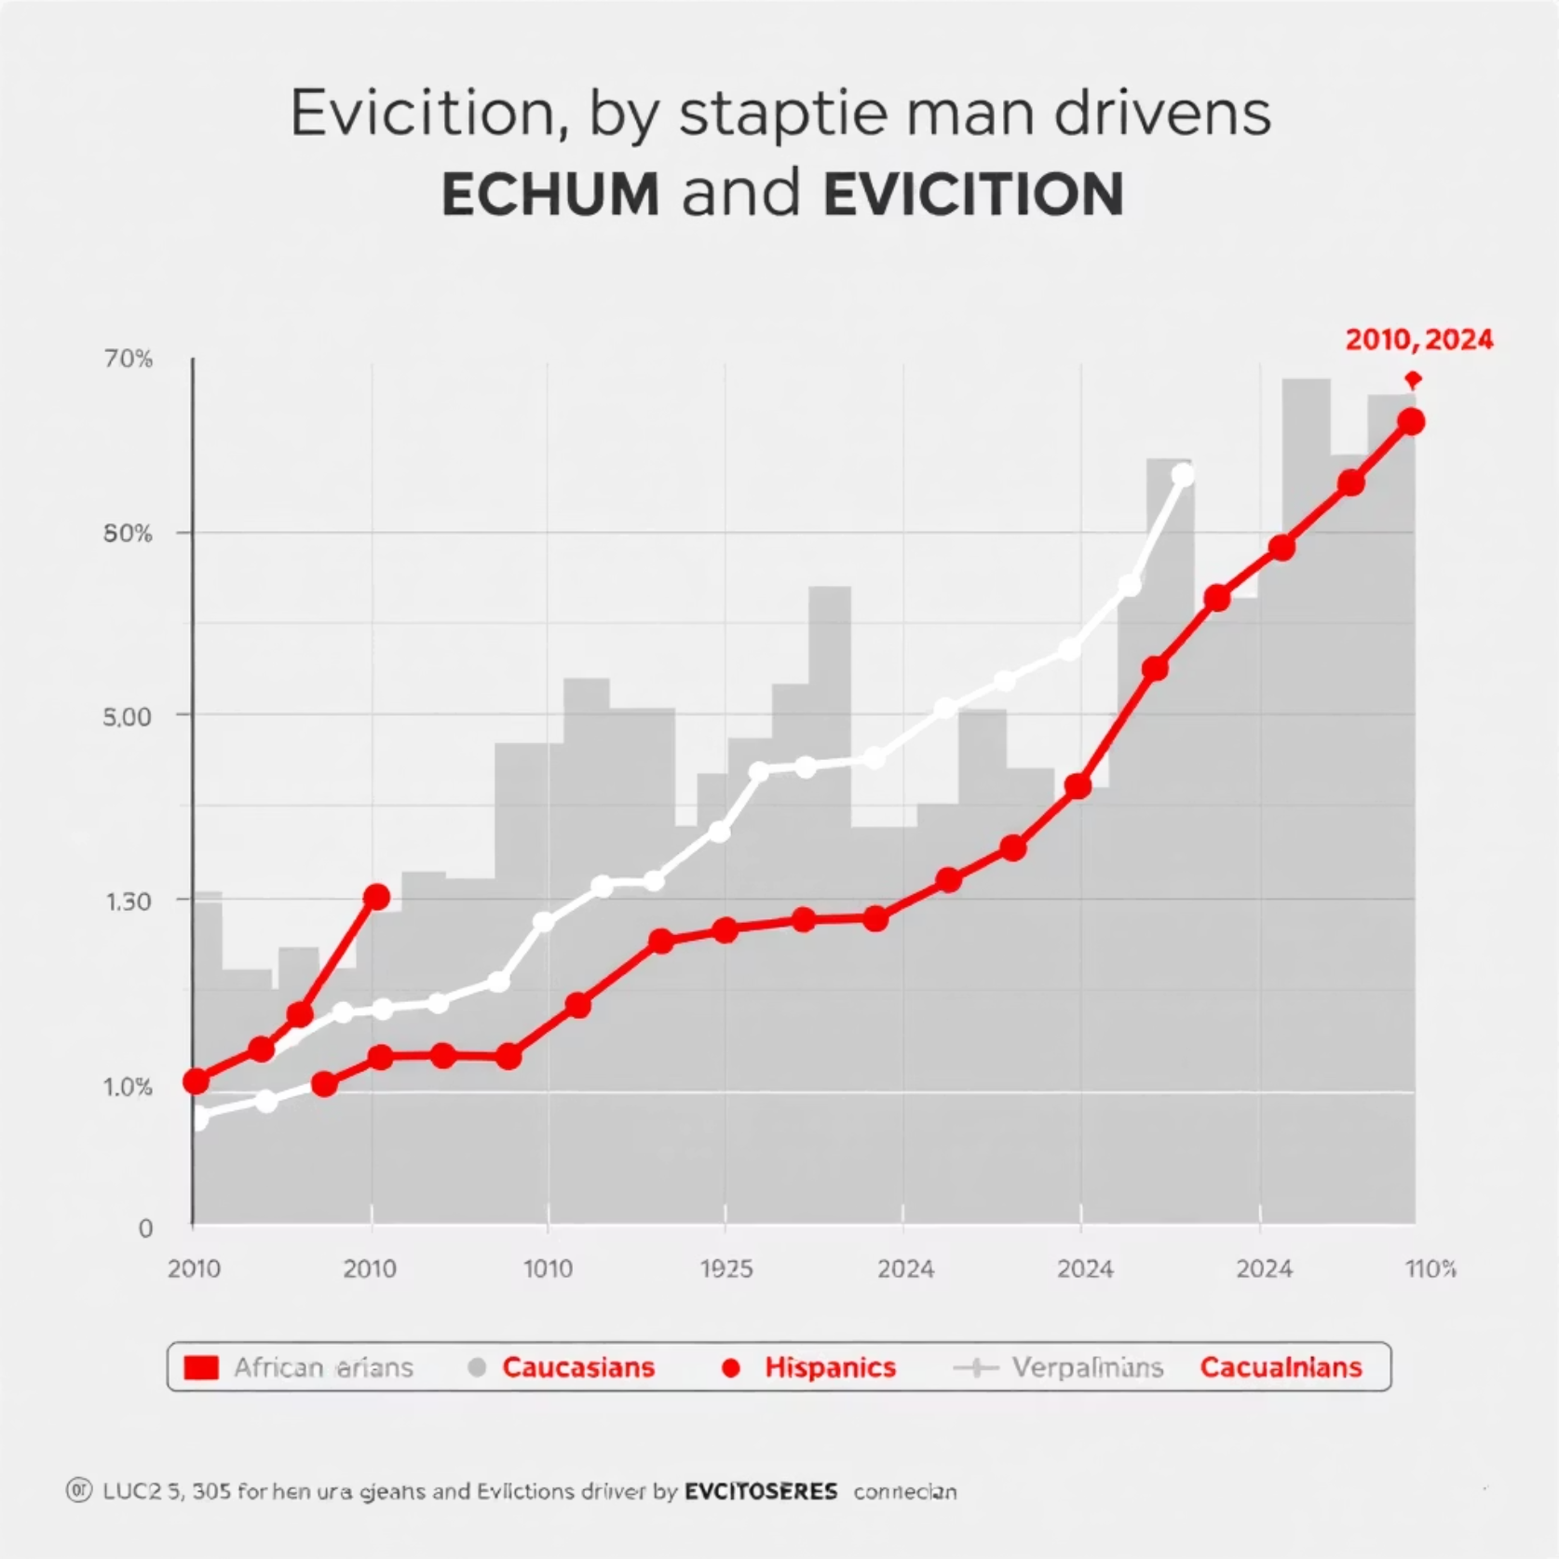
Temporal Trends (2020-2023)
Analysis of eviction rates from 2020 to 2023 revealed:
Eviction rates peaked in 2022 across all racial groups
Disparities persisted year-over-year, with Black-majority tracts consistently exhibiting the highest eviction rates
Some reduction in filings was observed in 2023, possibly due to intervention programs or pandemic policy wind-down

Slide 6

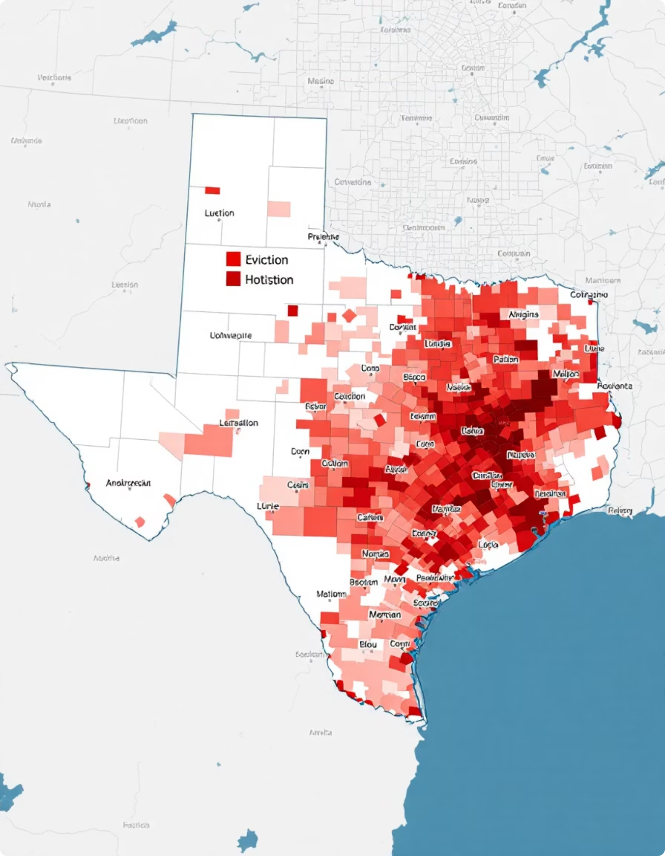


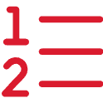
Geospatial Visualization
Using Texas tract shapefiles, we developed:
Choropleth Maps
Visual representation of eviction rates across Texas census tracts
Interactive Maps
Tooltips displaying engineered metrics and racial demographics
County Rankings
2023 eviction rate averages by county

Slide 7
Modeling and Bias Detection
Bias Detection Metrics
Example Findings
Group Mean Residual: Detects over/underprediction across racial groups
Disparate Impact between "High Renter = 1" and "High Renter = 0" groups: 1.92
Group MAE: Quantifies average error burden by group
High-Risk Conditional Bias:
Residual Variance by Group: Higher variance → model behaves less reliably
High Renter = 1: +0.84
Disparate Impact: Mean prediction ratio (ideally close to 1)
High Renter = 0: +0.15
This suggests model underestimates risk for high renter communities in high-eviction tracts.

Slide 8

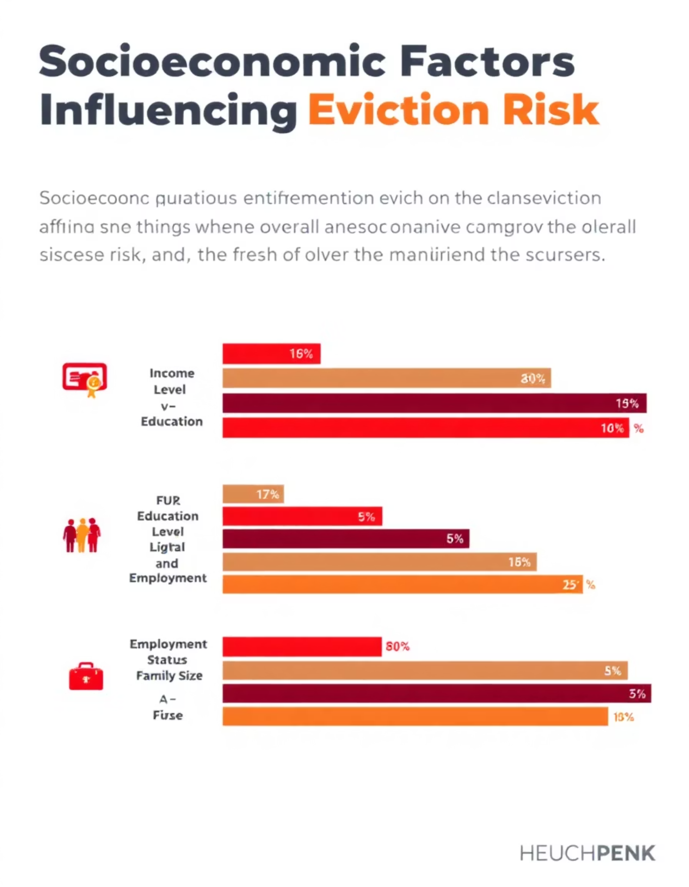
Drivers of Eviction Risk
Top Predictors (SHAP + Random Forest)
Youth Burden
High Renter
Pct Uninsured x HS or Less
Pct Renter x Poverty
Key Insights
PDPs show non-linear effects, with some features acting as sharp thresholds
SHAP confirms directionality: higher poverty or education burden drives eviction risk up
These are generalizable, structural markers of vulnerability, not proxies for race

Slide 9
Fairness Evaluation Metrics
Metric
Majority Black
Majority Hispanic
Majority White
Mixed/Other
Mean Residual
+0.5971
-0.2465
-0.2829
-0.0064
Mean Absolute Error
0.9734
0.4545
0.5423
0.5559
Residual Variance
5.77
0.44
10.83
1.33
Additional metrics: Disparate Impact Ratio (Black/White): 4.18, Fairness-Penalized MSE: 3.83 (vs RMSE-only of ~3.33)
Interpretation: The model underestimates eviction risk for White and Hispanic tracts but consistently underperforms for Black-majority areas, both in magnitude and variance.

Slide 10
Conclusions and Next Steps
Key Findings
Next Steps
This analysis reveals systematic disparities in eviction exposure, with structural indicators such as poverty, renter density, and low education interacting strongly with racial composition.
Expand analysis to predictive modeling using temporal and structural features
Integrate rental assistance and court intervention data
These findings can inform fair housing initiatives, eviction prevention policies, and targeted outreach in vulnerable communities.
Evaluate time-lag effects (e.g., 2022 conditions driving 2023 filings)
Apply similar methodology to other states for comparative insights
Prepared by: Israel Vargas / ITESM - MNA | Date: 07/28/2025

